Slide 1






Partnering for the future of education

Slide 2



Technical skills are more important than ever
By 2022, there will be 6.2 million job openings in cloud-based technology*
Employers are struggling to find employees with the right technical skills to meet their organizational objectives
Today’s students want more than a diploma—they want real-world skills that make them employable from the onset
Departments and faculty want the right resources to deliver innovative technical courses in order to meet their students’ needs
Employers highly value graduates who have their degree plus an industry-recognized certification**
*US Bureau of Labor Statistics
**MarketScale

Slide 3
Opportunities for educators

Slide 4

Microsoft Learn for Educators
Deliver cutting-edge tech instruction to students with confidence
Microsoft Learn for Educators provides institutions and educational non-profits with comprehensive resources to enable innovative technology education. Participating institutions and faculty gain access to Microsoft curriculum and teaching materials to easily offer in-demand content to students, while providing opportunities to earn industry-recognized certifications.
Teach tech skills for the future
Build students' technical skills with curriculum, educational materials, and tools provided by Microsoft.
Gear up for course delivery
Get access to training and tools that prepare faculty to deliver cutting-edge technical instruction.
Make an impact in students’ lives
Become a part of a global faculty community helping to prepare students for future careers.
aka.ms/MSLE

Slide 5
Microsoft Learn for Educators
Supporting tech skills education across the globe
Available in over 85 countries in 12 languages
Training and certifying 111,182 students with industry-recognized skills
Supporting 420 institutions to offer best-in-class technical curriculum
Giving 3,773 educators training, technology, and tools to prepare students
Last updated 2.15.22

Slide 6
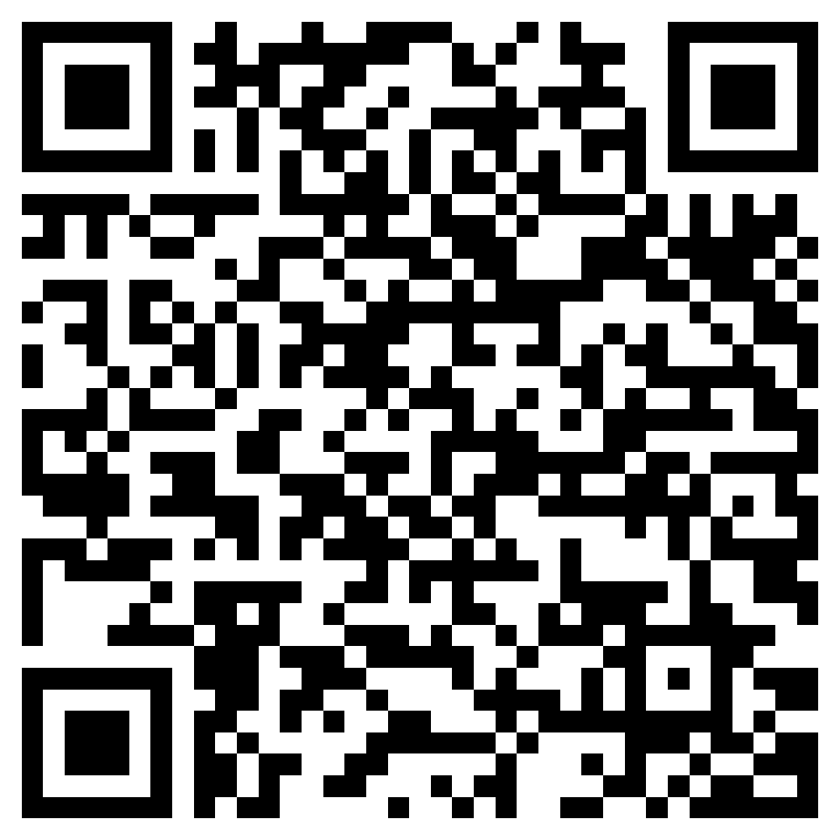

Get started today
Microsoft Learn for Educators
Build students’ technical skills while establishing a relationship with Microsoft
5
4
Prepare students with industry-recognized certifications.
3
Integrate curriculum and start teaching, training, and skilling your students.
2
Onboard and work with your Microsoft training program manager to access your materials, training, and certification voucher.
1
Apply to Microsoft Learn for Educators at http://aka.ms/MSLEInstitutionApply
Are you an Individual Educator? Sign up at http://aka.ms/MSLEEducatorSignUp
Identify a Program Advisor who acts as primary point of contact with Microsoft.

Slide 7
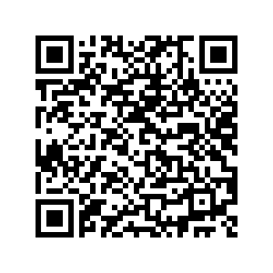
Azure Dev Tools for teaching
Azure Dev Tools for Teaching gives university students access to download more than 100 Microsoft Developer Tools, plus easy access for students to redeem Azure for Students.
STUDENT ID CARD
Option to redeem Azure for Students offer
100+ Free Developer Tools
Library of
Learning Paths
University Purchase
Student Access
OUTSIDE THE CLASSROOM
STEM Students wanting to learn on their own, participate in hackathons, or build their Imagine Cup project can access dev tools that simplify their journey.
INSIDE THE CLASSROOM
Available to all STEM courses, Azure Dev Tools for Teaching provides the tools needed (such as IDE) for students to learn and complete projects
USAGE SCENARIOS
Notes:
Free to customers with an EES agreement or can be purchased at $499 annually
Access to tools commonly used for STEM programmes including professional developer and designer tools, software and services that professors can use for their students and provide access to
Visual Studio and Integrated development environment
Azure Lab Services – tool to enable educators to set up and provide on demand access to preconfigured VMs to support classroom scenarios.

Slide 8
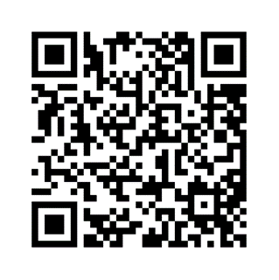





Azure Lab Services
A tool to set up and provide on-demand access to preconfigured virtual machines (VMs) to support classroom scenarios in Higher Education. Teach a class, train professionals, run a hackathon or a hands-on lab, and more. By defining requirements the service will roll the lab out to the agreed audience.
Faculty staff can create labs and support their classes without IT intervention
Provides lab resources to students in any location from any device
All inclusive pricing model
Define availability of lab resources to only pay for what is used
Set up from one cloud based PC with all the software and files needed for the class

Slide 9
Opportunities for students

Slide 10
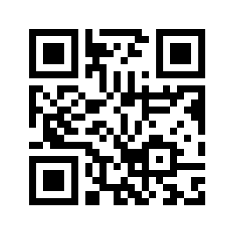
Azure for students
Azure for Students gives worldwide university students (ages 18+) access to more than 25 free Azure services, plus $100 in Azure credit. It also provides students access to downloadable Dev Tools and learning paths in one convenient place:
AZURE EDUCATION HUB
STUDENT ID CARD
$100 Azure
Credit
25+ Free Azure Services
14 Free Developer Tools
Library of Free Learning Paths
Verify as Student
(No credit card required)
PAY NOTHING: Ability to convert to Pay as You go or renew annually
OUTSIDE THE CLASSROOM
Students wanting to learn on their own, participate in hackathons, or build their Imagine Cup project.
INSIDE THE CLASSROOM
Limited to courses like Data Analytics, Machine Learning, Statistics and Probabilistic Modeling with low to moderate resource demands
USAGE SCENARIOS
aka.ms/azure4students
Notes:
Age restrictions apply for certain programs
Azure for Student 18+
Azure for Student Starter 13+ US, 16+ ROW
LinkedIn 16+

Slide 11
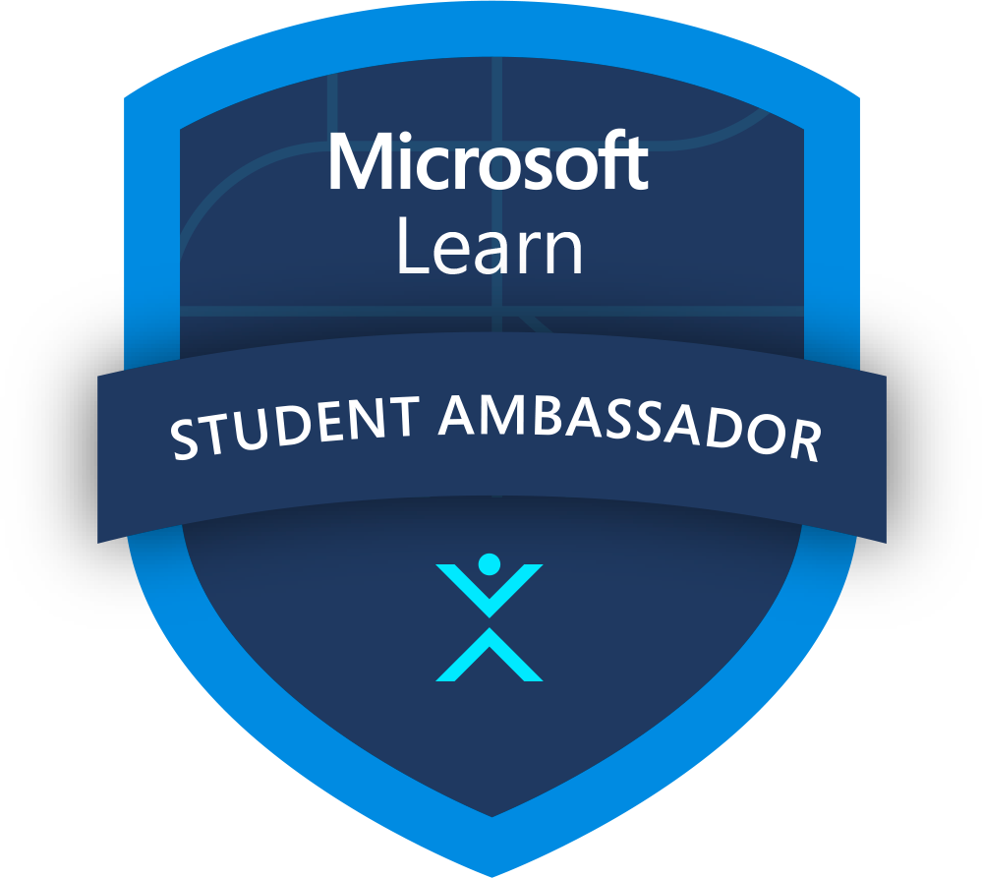
Microsoft Learn Student Ambassadors
Finding your community is more important than ever as classes, events, and even social activities take place virtually. Amplify your impact as a passionate student leader and bring together like-minded peers to build vibrant digital communities across the globe, learn new skills, and solve real-world problems.
Connect with other students who share your passion in focused Leagues and use tech to solve real-world challenges together
Kick-start your career with training and certifications, support for virtual events, and unique access to experts and mentors
Host digital events, offer guidance to other students, and earn recognition that separates your résumé from the pack
Applications are open year-round and selected students are onboarded quarterly!
StudentAmbassadors.com | #MSFTStudentAmbassadors
Notes:
Aligned to one of Microsoft’s key educational offerings
Skilling students with our hands-on learning platform
Continued learning for community after engagements
Preparation for certification
Involved in bigger initiatives within Microsoft
Become a closer partner with Microsoft
Provide feedback, feature requests, and report issues with content
Additional Benefits and Platform Extensions
Certification Exam Vouchers
Free Domain Name
Public Profile and Community Events
Program Nominations
You might find yourself helping fellow students build their coding skills online with Microsoft Learn, organizing a virtual hackathon to solve real-world challenges, earning certifications, or building digital communities—it’s all up to you.

Slide 12

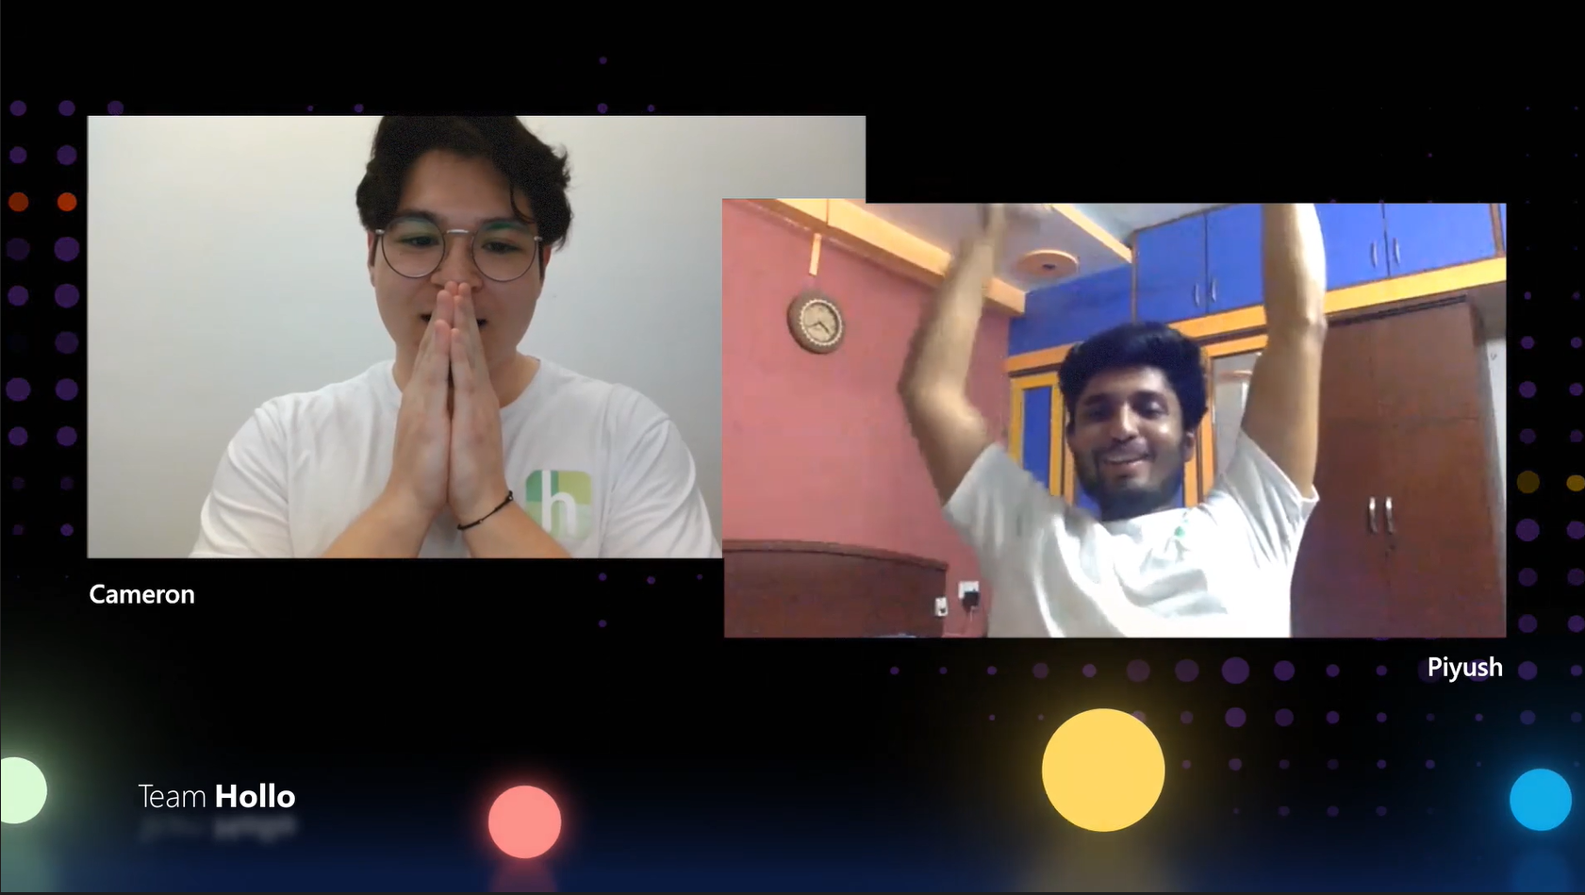


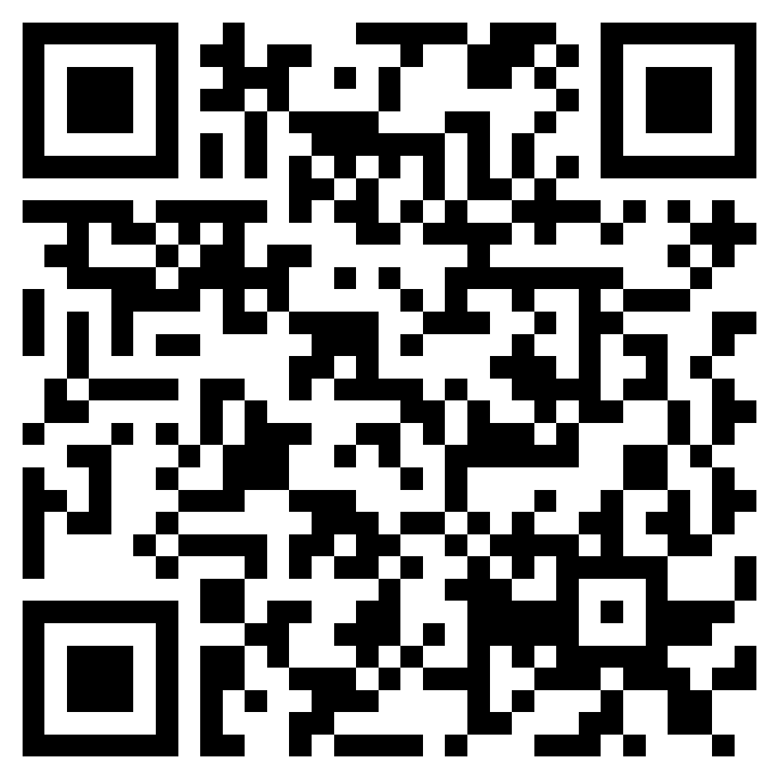
Imagine Cup
Want to be the protagonist of the next edition?

Slide 13

Journey to the 2022 World Finals – our 20th Anniversary
Launched in September 2021 – tens of thousands of students registered from over 150 countries
Thousands of competitors submitted projects
We are down to the top 48 top teams across 3 regions – Americas, Asia, and EMEA (Europe, Middle East, and Africa)
Judges in each region will select a 1st place team in each category, with the top team in the region moving on to the World Championship
The 3 teams selected to advance to the World Championship will receive $5,000 USD and Microsoft Azure credits
The 9 other category winning teams will receive $2,500 USD and Microsoft Azure credits
World Champion team wins $100,000 USD and mentoring session with Microsoft CEO, Satya Nadella!

Slide 14
Useful links
Azure for Students: https://azure.microsoft.com/free/students
Azure Dev Tools for Teaching: http://aka.ms/azuredevtoolsforteaching
Microsoft Learn Student Ambassadors: http://aka.ms/studentambassadors
Microsoft Learn Educators: https://docs.microsoft.com/learn/educator-center/programs/msle/program-instructions
Internship Learning Path on Learn: https://docs.microsoft.com/learn/paths/start-career-in-tech
Learn for Students: https://docs.microsoft.com/learn/browse/?roles=student
Microsoft Learn Educator Center: https://aka.ms/educenter
Microsoft Research Academic Programs: https://aka.ms/researchfaculty
Azure for Education: https://azure.microsoft.com/developer/students/
Educator Developer Blog: https://aka.ms/faculty
Azure Lab Services: https://aka.ms/azurelabservices
GitHub Classroom: https://classroom.github.com/
GitHub Codespaces: https://github.com/features/codespaces
Notes:
Aligned to one of Microsoft’s key educational offerings
Skilling students with our hands-on learning platform
Continued learning for community after engagements
Preparation for certification
Involved in bigger initiatives within Microsoft
Become a closer partner with Microsoft
Provide feedback, feature requests, and report issues with content
Additional Benefits and Platform Extensions
Certification Exam Vouchers
Free Domain Name
Public Profile and Community Events
Program Nominations
You might find yourself helping fellow students build their coding skills online with Microsoft Learn, organizing a virtual hackathon to solve real-world challenges, earning certifications, or building digital communities—it’s all up to you.

